Slide 1
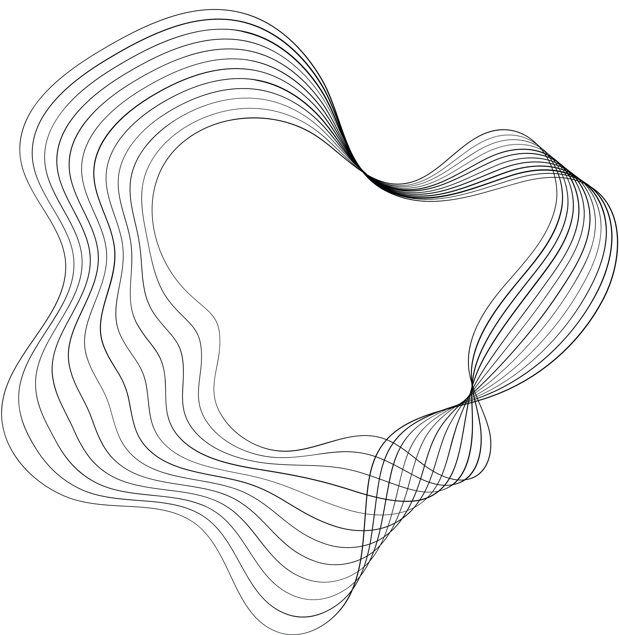

PROJECT
CONNECT 4
APPLIED SYSTEM SOFTWARE – DIP392
MEHMET SAHIN UCES – 211ADB056
PARVIZ ATAKISHIYEV – 211ADB059

Slide 2

CONTENT
01
ABOUT THE PROJECT
02
SOFTWARE REQUIREMENTS
03
DESIGN CHOICE
04
TESTING
05
OUTCOMES AND LEARNINGS
06
DEMONSTRATION
Notes:
Before starting to explain the main things about our project, let me introduce you with the agenda. Firt we have the information about the project, Next is the software requirements that we set. Following is Design Choices, testing and Outcomes and Learnings we had from this course. Lastly, we will have the demonstration of the game.

Slide 3




ABOUT THE PROJECT
The goal is to create a digital version of the traditional game Connect Four. The game should be allowing for two-player and turn-based matches.
Responsive game play
Simple design
Classic connect 4 game play
Notes:
Our main goal in this project was to create the traditional Connect 4 game. The game we created allows two player to interact and has a turn-based mechanism. 3 of the main tasks during this work were responsive gameplay, simple designm and Classic Connect 4 game play. Responsive game play indicates that there is no lag or no latency. Simple design is for the better understanding as indicated target audience is children who are approaching school age.

Slide 4


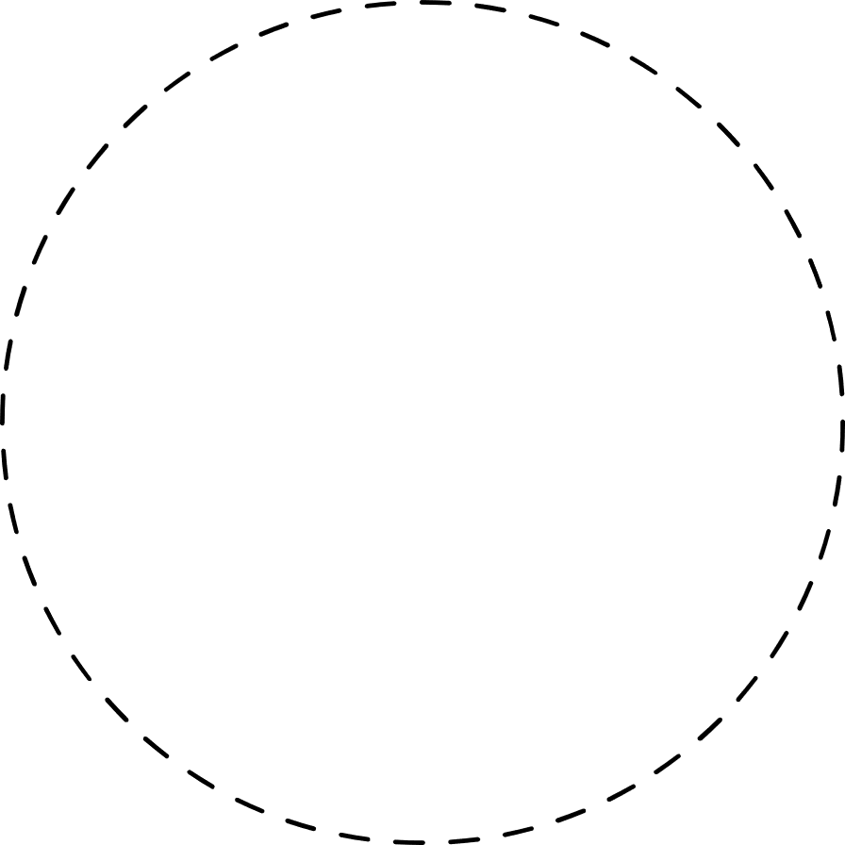


Software Requirements
Functional
Non-Functional
Game board
Player pieces
Turn mechanism
Input
Game conditions
Visual feedback
Game restart
User-friendly UI
Clarity
Notes:
Moving on to the Software Requirements we have mainly two type of requirements included which are nonfunctional and functional. For functional requirements we included Game-board, player pieces , turn mechanism, game conditions and visiual feedback we are the basis of the game.
For Non-functional requirements we have user-friendly Ui and clarity.

Slide 5

Design Choice
Modular
Monolithic
UI
Game condition
Utility
Board
Pieces
Rendering
Turn
Game result
Game
Win condition
UI
Game result
Board
Turn
Pieces
Piece
Location
Color
Pros
Scalability
Reusability
Cons
Complexity
Cost
Pros
Simplicity
Efficiency
Cons
Scalability
Flexibility
Notes:
When it comes to the design choice, we had 2 choices in mind which are modular and monolithic. Starting with modular it is possible to say that, every aspect of the game has a specific module which contains code/implementation process inside. Advantages of this kind of design is that it is scalable and reusable. Each component in modular design is independent and can be developed in that way. New features can be added or deleted with the minimal impact on other modules. Reusable means modules can be used again which leads to fewer bugs and faster development. As a disadvantage modular design is complex and costly.
On the other hand, Monolithic design has 3 main classes and the other aspects of the project is seperated among these 3. This kind of design is simple, and efficient. It is simple to understand and manage especially for small projects like connect4. Also, as the components are tighlty coupled, communication between them is fast.
As disadvantages of monolithic design, Scalability and Flexibility can be mentioned.if the project grows this design will be hard to manage and scale. Adding new features might require huge changes. Lastly the made changes in one part of the system can cause an impact on the other parts which illustrates the low flexibility.

Slide 6
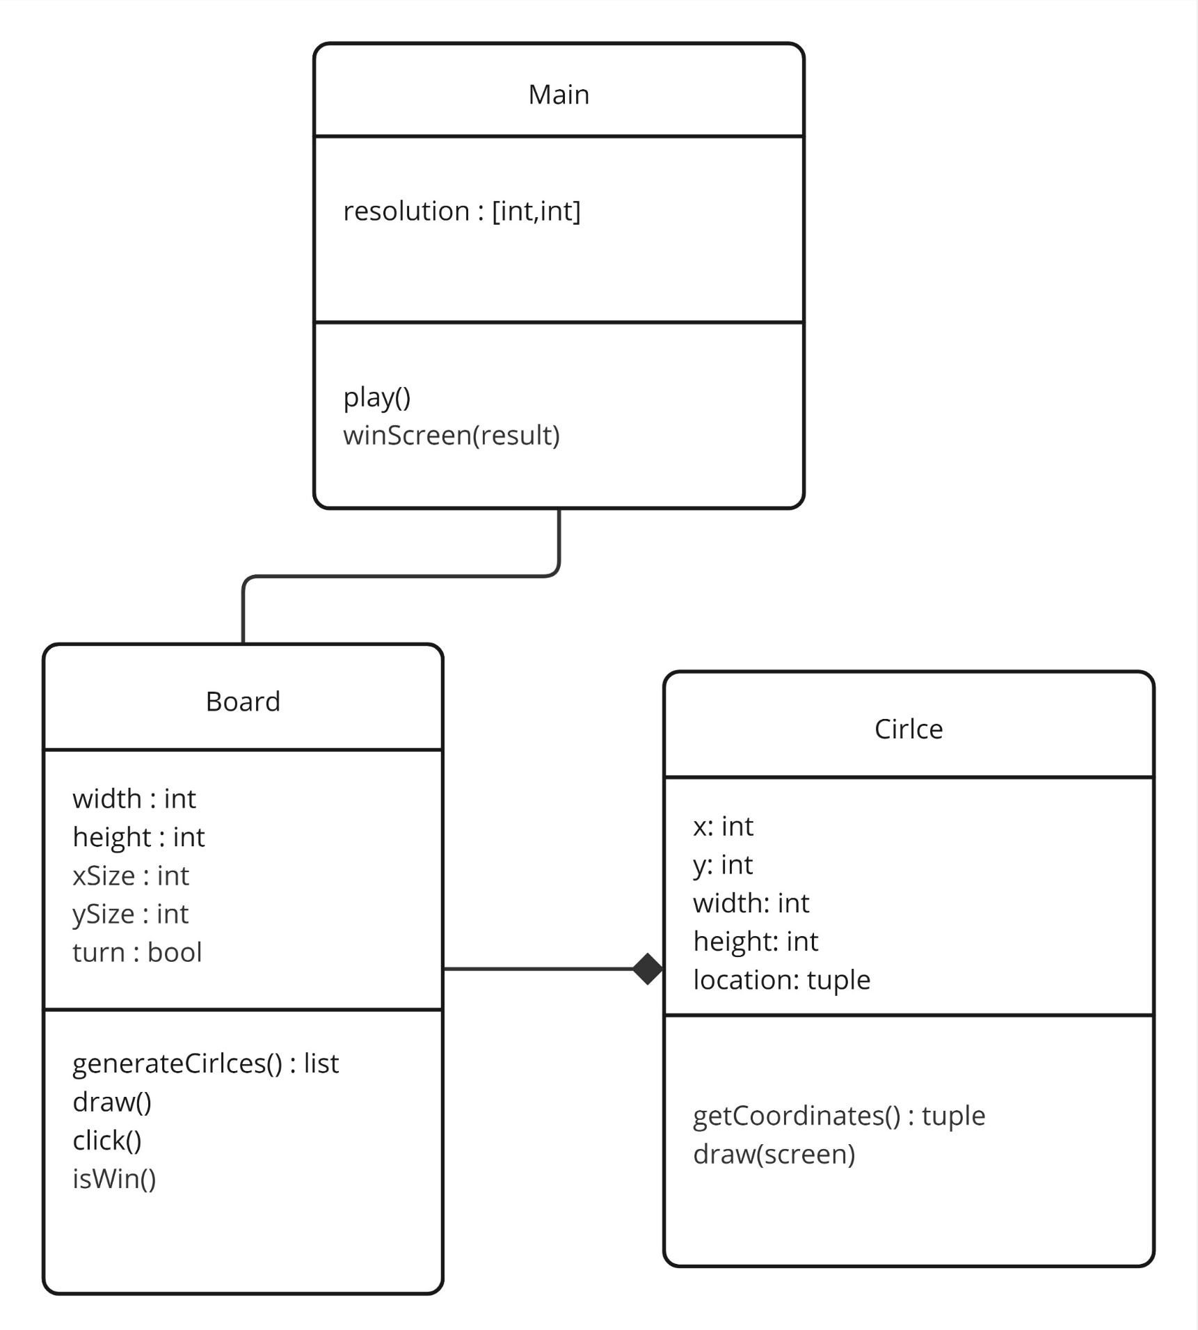
We decided on Monolithic design because:
Simplicity
Faster development
Clear and static requirement
Notes:
We have opted for monolithic design because, as my friend mentioned, the design itself is simple to develop and with this simplicity makes implementation phase shorter. Additional to this, projects that have static requirements such as the connect 4, can benefit this design since the potential change in the requirements is not likely. Here you can see UML diagram of our early design phase.

Slide 7

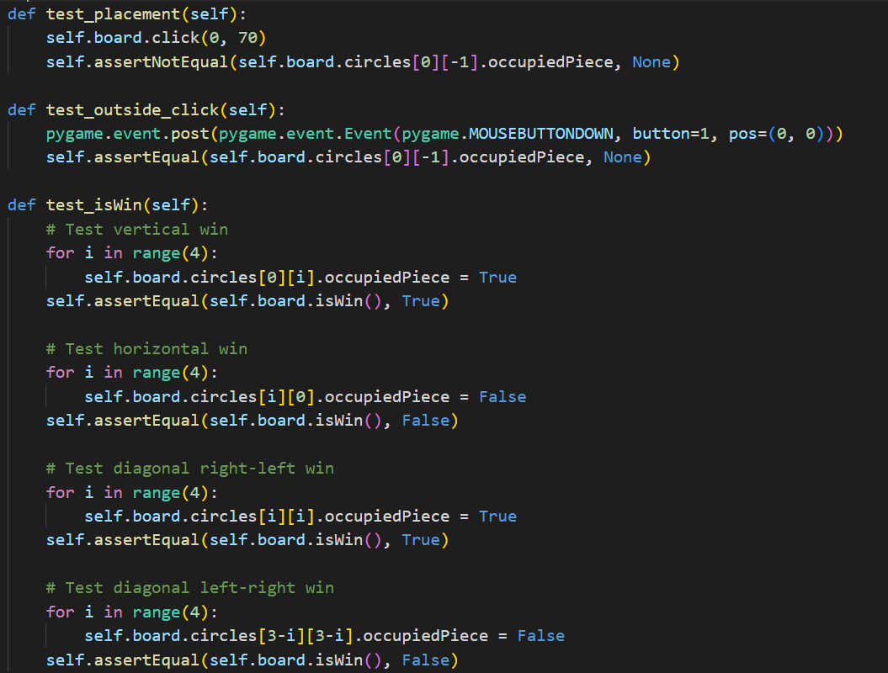
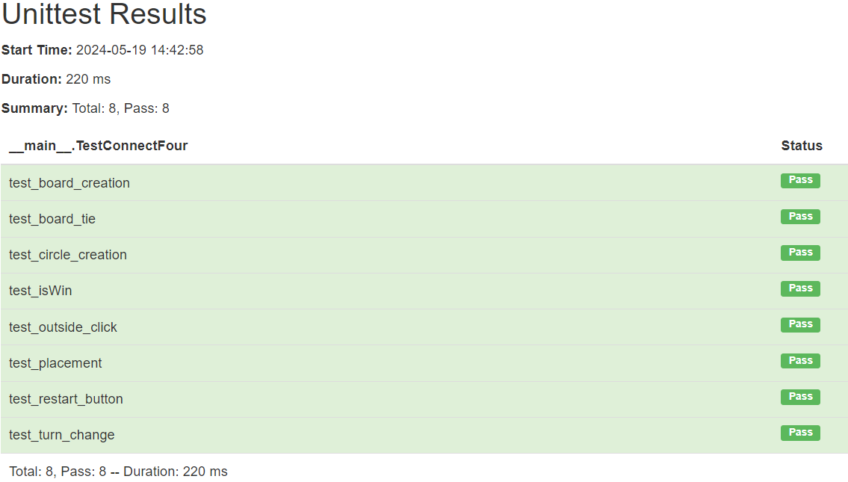
Testing
Notes:
As for every project, testing is important aspect of our project. We have aimed to test all the functions that are necessary for our game to function properly such as clicks on a valid area and invalid areas, win conditions and restarting the game. On the right you can see a snippet from our test code. And on the left, you can see the report of our testing.

Slide 8
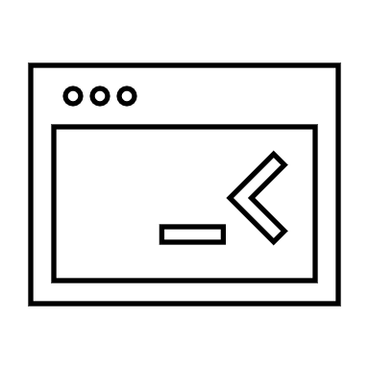

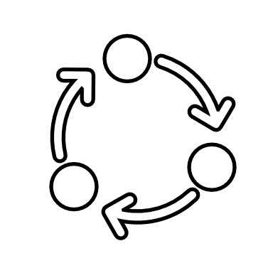

OUTCOMES AND LEARNINGS
OOP principles to organize code into classes and objects leading to a more organized and maintainable codebase
Using Waterfall development method to arrange events sequentially, following phases step by step.
Practicing Software Design Life Cycle through several steps such as : Plan, Design, Implement and Test.
OOP
Waterfall
SDLC
Notes:
For Connect 4, we applied OOP principles to structure our code into manageable classes and objects, improving codebase organization and maintainability.
Using the waterfall development method, we carefully planned and executed each phase sequentially, ensuring a smooth progression from design to implementation.
In addition, we adhered to the Software Development Life Cycle (SDLC) framework, which guided us through key stages such as planning, design, implementation, and testing.
This reinforced a systematic approach to software development.

Slide 9
DEMONSTRATION
Notes:
Now before finishing the our presentation we would like to show you our game.

Slide 10
THANK YOU FOR YOUR ATTENTION!

